Slide 1
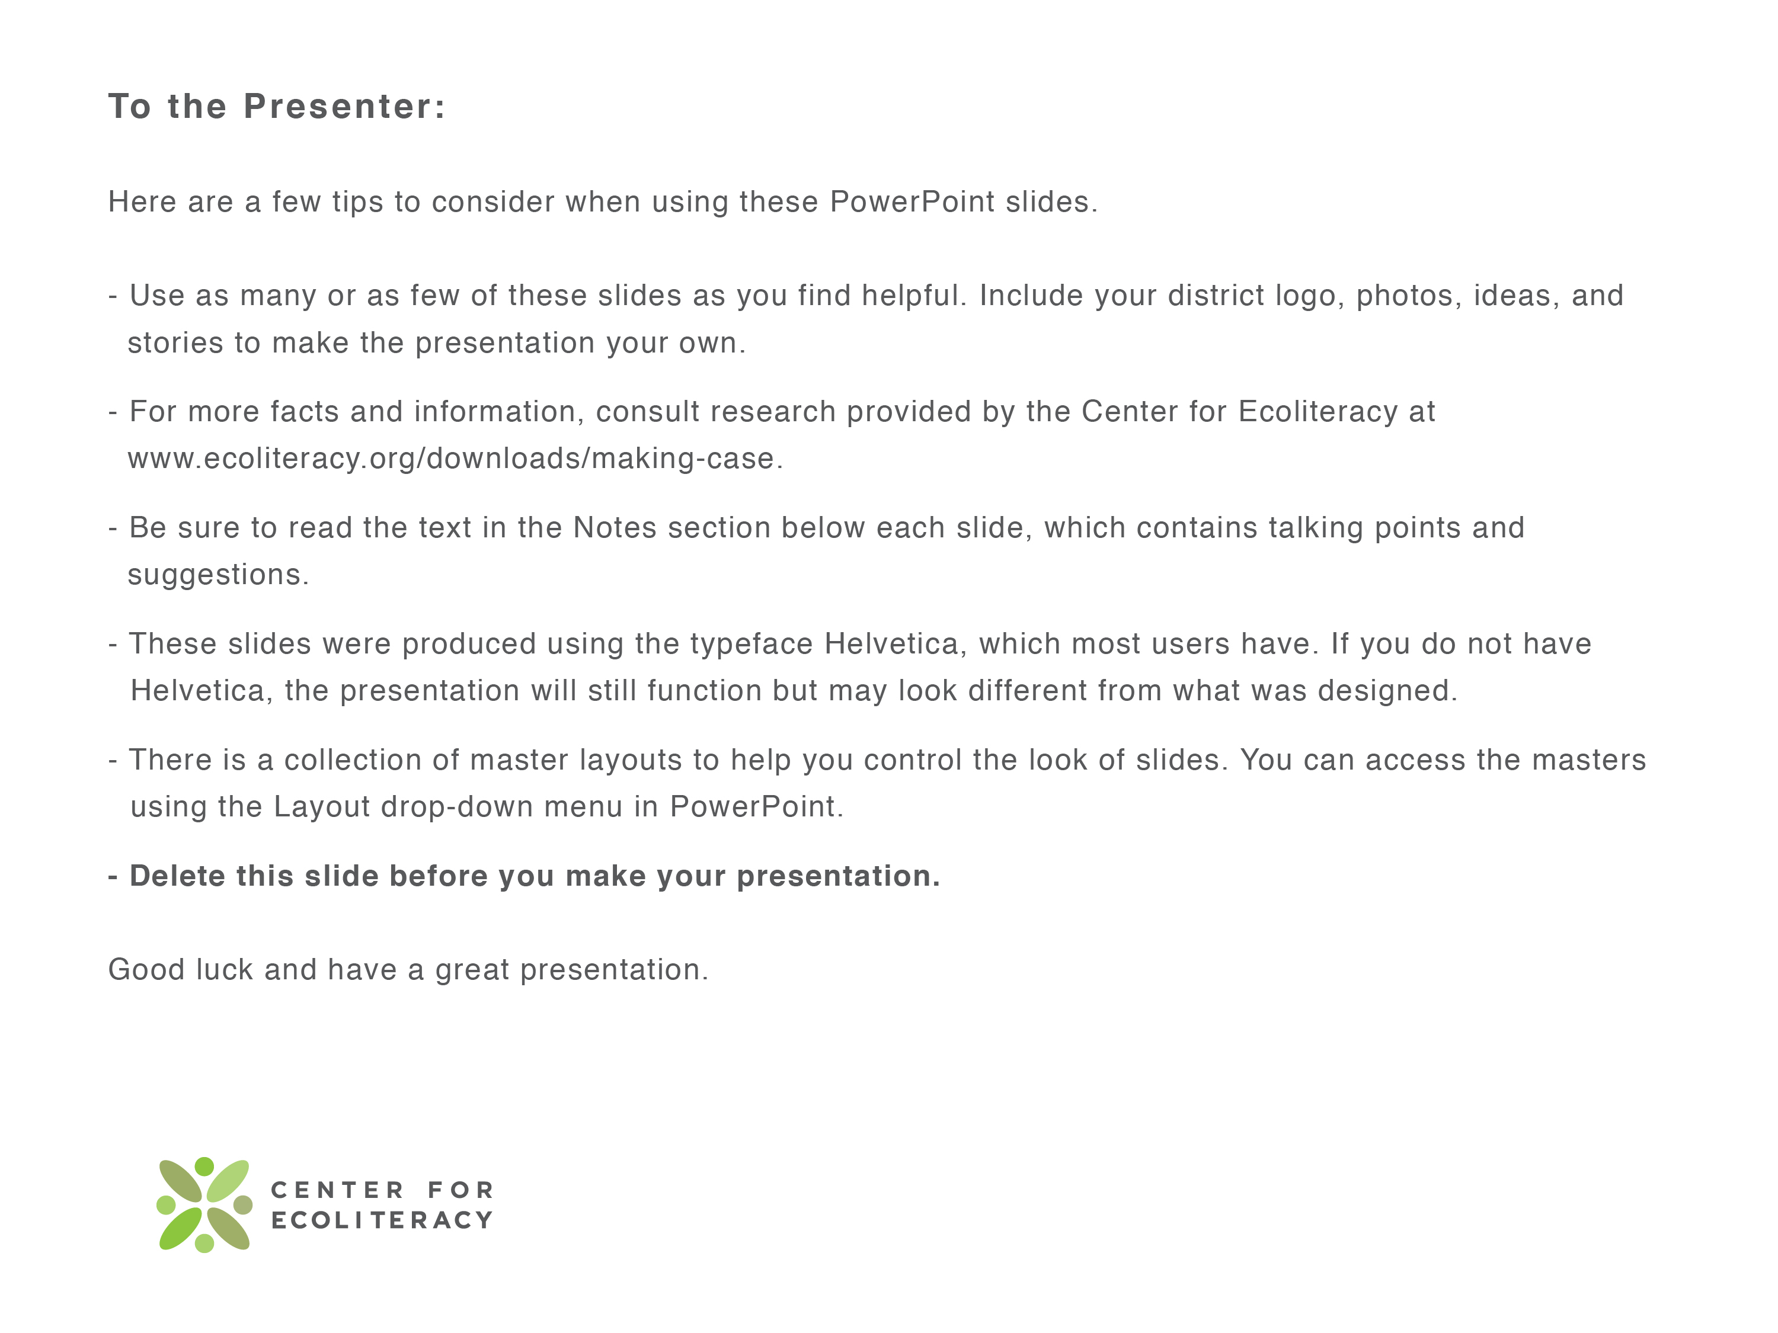
barrels of oil to make one automobile
Notes:
[NOTE TO PRESENTER: Be sure to delete this slide before you deliver your talk.]

Slide 2

barrels of oil to make one automobile
Notes:
[NOTE TO PRESENTER: Consider making your own title slide and including your district’s logo.]

Slide 3
School meals are a big opportunity for positive change.
Notes:
School meals are a big opportunity for positive change.

Slide 4
How big?
parts
Notes:
How big is it?

Slide 5
School is the biggest restaurant chain in every city and every town. Only nobody knows it.
David Binkle
Director, Food Service
Los Angeles Unified School District
Notes:
David Binkle, the food service director at Los Angeles Unified, says that, “School is the biggest restaurant chain in every city and every town. Only nobody knows it.”

Slide 6
What do the numbers
look like?
Notes:
What do the numbers look like?

Slide 7
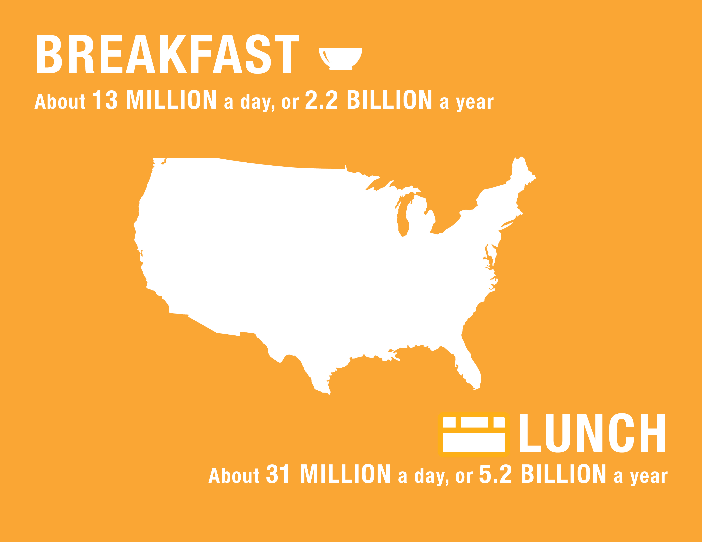
USDA
Notes:
The USDA estimates about 13 million breakfasts were daily in 2013, or about 2.2 billion a year.
About 31 million lunches were served daily in 2013, or 5.2 billion a year.
And that’s just breakfast and lunch. It doesn’t count the snacks or supper.
[NOTE TO PRESENTER: Consider adding a slide after this one that shows YOUR district’s daily and monthly meals.]

Slide 8
Percent of daily calories that an average child eats at school
35%
Action for Healthy Kids
Notes:
Furthermore, on average, students consume about 35 percent of their daily calories at school.

Slide 9
Many children get more than half of their calories at school.
50%+
Journal of the American Dietary Association
Notes:
And many students get half or more of their calories from school meals.

Slide 10
Why does this matter?
Notes:
Why does this matter?

Slide 11
Because school districts have a significant role to play in the well-being and academic achievement
of children.
parts
Notes:
Because school districts have a significant role to play in the well being and academic achievement of children.

Slide 12
And freshly prepared, healthy school meals are part of the strategy that helps districts succeed.
parts
Notes:
And freshly prepared, healthy school meals are part of the strategy that helps districts succeed.

Slide 13
How?
Notes:
How?

Slide 14
Improved school meals can make an almost immediate difference
in academic achievement.
Journal for Health Economics
Notes:
In fact, according to the Journal for Health Economics those meals make an almost immediate difference in academic achievement.

Slide 15
And they have a positive effect on attendance and test scores, too.
California School Board Association; Emery University
Notes:
And have a positive effect on attendance and test scores, too.

Slide 16
School meals are especially important
for some students.
parts
Notes:
School meals are especially important for some students.

Slide 17
Number of Americans who lived in food insecure households in 2012
49 MILLION
USDA
Notes:
That’s because of the numbers of hungry kids in school. In 2012, 49 million Americans lived in food insecure households.

Slide 18
Number of children who lived in food insecure households in 2012
15.9 MILLION
USDA
Notes:
That includes almost 16 million children.

Slide 19

1 out of 5
U.S. households with children who
report food insecurity
USDA
Notes:
In 2012, 1 out of 5 households with children reported food Insecurity.

Slide 20
In addition to alleviating
hunger, healthy school
meals help to promote
overall student health.
parts
Notes:
In addition to alleviating hunger, healthy school meals help to promote overall student health.

Slide 21
This is especially significant when you consider one of the biggest health challenges in the history of this country –– obesity.
parts
Notes:
This is especially significant when you consider one of the biggest health challenges in the history of this country –– obesity.

Slide 22
Americans are overweight or obese
1out of 3
Journal of the American Medical Association
Notes:
1 out of 3 American children are overweight or obese

Slide 23
In some communities it’s half.
1out of 2
Journal of the American Medical Association
Notes:
In some communities it’s half

Slide 24
Obesity is a better
predictor for absenteeism
than any other factor.
barrels of oil to make one automobile
A study cited in Fit, Healthy, and Ready to Learn
Notes:
Obesity is a better predictor for absenteeism than any other factor.

Slide 25
Obese children often
have health problems
including bone fractures, hypertension, and
diabetes that cause
them to miss school.
Pediatrics
Notes:
Obese children are more likely to have health problems like bone fractures that keep them away from school and more likely to develop hypertension, diabetes, sleep apnea, menstrual abnormalities, impaired balance, and orthopedic problems at an earlier age than their normal-weight peers.

Slide 26
When students miss school, they fall behind academically and become socially isolated.
Notes:
When students miss school, they fall behind academically and become socially isolated.

Slide 27
In states that determine
funding by average daily
attendance, each day
a student is absent
decreases district income.
Notes:
In states that determine funding by average daily attendance, each day a student is absent decreases district income.

Slide 28
Schools with healthy eating programs have significantly lower
rates of obesity.
Kaiser Permanente
Notes:
But the good news is that schools with healthy eating programs have significantly lower rates of obesity.

Slide 29
And those same healthy
meals also help
increase participation which increases revenue.
Notes:
Better meals help increase participation. Here are a few examples from the field.

Slide 30
Examples from the field
Notes:
Here are a few examples from the field.
[NOTE TO PRESENTER: Consider including your own accomplishments to this section. This is your time to brag!]

Slide 31
In California, Turlock Unified
increased participation by 300% when the district launched a campaign to promote its fresh offerings to students.
Center for Ecoliteracy
Notes:
Here are just a few examples. In Turlock, participation increased 300% when the district rolled out a campaign to promote its fresh offerings to students.
[NOTE TO PRESENTER: This and other innovation stories are available at http://www.ecoliteracy.org/essays/california-food-california-kids-awards.]

Slide 32
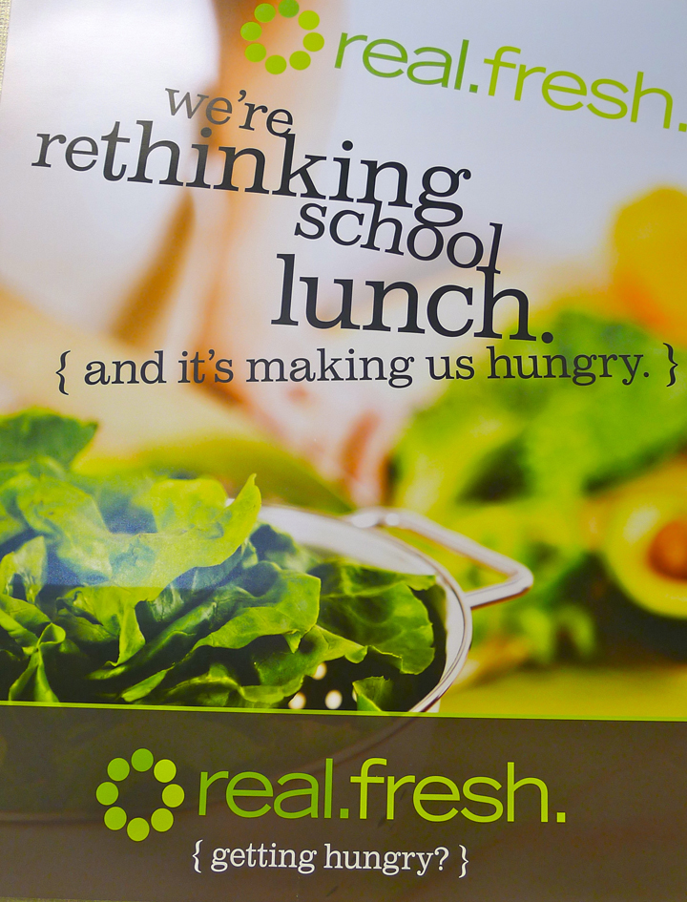
Notes:
Here is an example of a poster from their marketing program.

Slide 33
Does fresh food cost more?
It might, but participation
and revenue will far outweigh
the cost.
Scott Soiseth
Director, Child Nutrition Services
Turlock Unified School District

Slide 34
At San Diego Unified,
participation increased from
18 to 25 million meals a year when food carts were used to
serve healthy school meals.
Center for Ecoliteracy
Notes:
Here are just a few examples. In San Diego, participation increased from 18 to 25 million when food carts were used to serve healthy school meals.
[NOTE TO PRESENTER: This and other innovation stories are available at http://www.ecoliteracy.org/essays/california-food-california-kids-awards.]

Slide 35
Breakfast helps kids get to
school on time. And they go
to the nurse less.
Gary Petill
Director, Food and Nutrition Services
San Diego Unified School District

Slide 36
In Ventura County,
average daily participation
doubled when five districts worked together to improve the quality of their meals.
Center for Ecoliteracy
Notes:
In Ventura County, average daily participation more than doubled when 5 districts worked together to improve the quality of their meals.
[NOTE TO PRESENTER: This and other innovation stories are available at http://www.ecoliteracy.org/essays/california-food-california-kids-awards.]

Slide 37
Getting staff engaged in training has been the biggest advantage in our success.
Sandy Curwood
Director, Food and Nutrition Services
Ventura Unified School District

Slide 38
Working collectively, schools can help create enough demand to support
sustainable regional agriculture...
Notes:
Working collectively, schools can help create enough demand to support sustainable regional agriculture...

Slide 39
…as has been demonstrated in so many successful
farm-to-school programs.
Notes:
…as we have seen in so many successful farm to school programs.

Slide 40
These successes can
translate into local
prosperity.
Notes:
These successes translate can into local prosperity.

Slide 41
Every dollar spent locally equals
$1.86 added to the economy.
$1= $1.86
Ecotrust
Notes:
According to an EcoTrust study, every dollar spent locally equals $1.86 added to the economy

Slide 42
Every job created by a district’s purchasing results in an overall increase of 2.43 jobs.
1JOB = 2.43 JOBS
Ecotrust
Notes:
Every job created by a district’s purchasing results in an overall increase of 2.43 jobs

Slide 43
The power of healthy school meals is well recognized by the public.

Slide 44
2013
Kaiser Permanente Survey
Notes:
For example, in 2013 nationwide research conducted for Kaiser Permanente revealed that…

Slide 45
64%
Adults who agree schools should take
a major role in reducing obesity
Kaiser Permanente
Notes:
64% of adults think schools should take a MAJOR role in reducing obesity.

Slide 46
78%
Adults who agree healthier school meals
affect academic performance
Kaiser Permanente
Notes:
78% agree healthier school meals affect academic performance.

Slide 47
88%
Adults who favor new USDA
meal standards
Kaiser Permanente
Notes:
And 88% favor new the USDA meal standards.

Slide 48
Some communities have
used this support to advance successful ballot measures.
Notes:
Some communities have used this support to advance successful ballot measures.

Slide 49
In fact, surveys have shown that ballot measures are more
attractive when they include provisions for improved
school meals.
Center for Ecoliteracy
Notes:
In fact, surveys have shown that measures are more attractive when they include provisions for improved meals.

Slide 50
Here’s an example…
Notes:
Here’s an example.

Slide 51
In 2012, Oakland schools
sought funding for improved facilities, including a new central kitchen, education center, and a 1.5-acre campus farm.
Notes:
For example, in 2012, Oakland schools sought funding for improved facilities, including new kitchens, a learning center, and a 1.5 acre campus farm.

Slide 52
It was called Measure J.
Notes:
Here’s an example.

Slide 53
to improve school facilities in Oakland
$475 MILLION
Notes:
It was a bond measure for $475 million, $44 million of which was for food-related facilities and programs.

Slide 54
percent by which measure J passed
83.6%
Notes:
Measure J passed by almost 84%. This is not unique. Support for healthy, freshly prepared school meals is strong all over the country.

Slide 55
It’s a huge success and
a vision we all can share.
Notes:
It’s a vision we can share.

Slide 56
Healthy children.
Notes:
Healthy children.
[NOTE TO PRESENTER: Consider including photographs from your district that show healthy children and good food.]

Slide 57
Improved learning outcomes.
Notes:
Improved learning outcomes.
[NOTE TO PRESENTER: Consider including photographs from your district that show healthy children and good food.]

Slide 58
Healthier local economies,
including more jobs.
Notes:
Healthier local economies, including more jobs.
[NOTE TO PRESENTER: Consider including photographs from your district that show healthy children and good food.]

Slide 59
More prudent use of our
resources, including
natural resources.
Notes:
More prudent use of our resources, including natural resources.
[NOTE TO PRESENTER: Consider including photographs from your district that show healthy children and good food.]

Slide 60
And the opportunity to make
a real and lasting
contribution
to the future.
Notes:
The opportunity to make a real and lasting contribution to the future.
[NOTE TO PRESENTER: Consider including photographs from your district that show healthy children and good food.]

Slide 61
barrels of oil to make one automobile
Notes:
[NOTE TO PRESENTER: Consider making your own title slide and including your district’s logo.]

Slide 62
With thanks to the Center for Ecoliteracy
www.ecoliteracy.org

